Slide 1

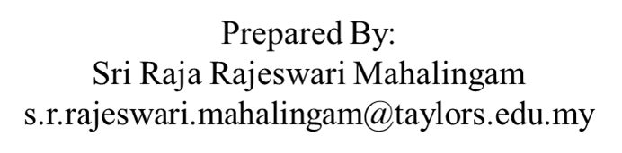
APPLICATION CHEMISTRY
A2 LEVEL
BIOCHEMISTRY
CHAPTER 2: ENZYMES

Slide 2
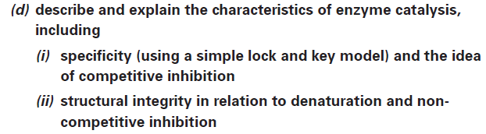
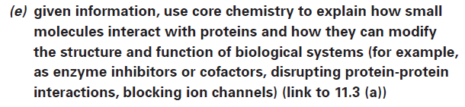
What you should know…

Slide 3
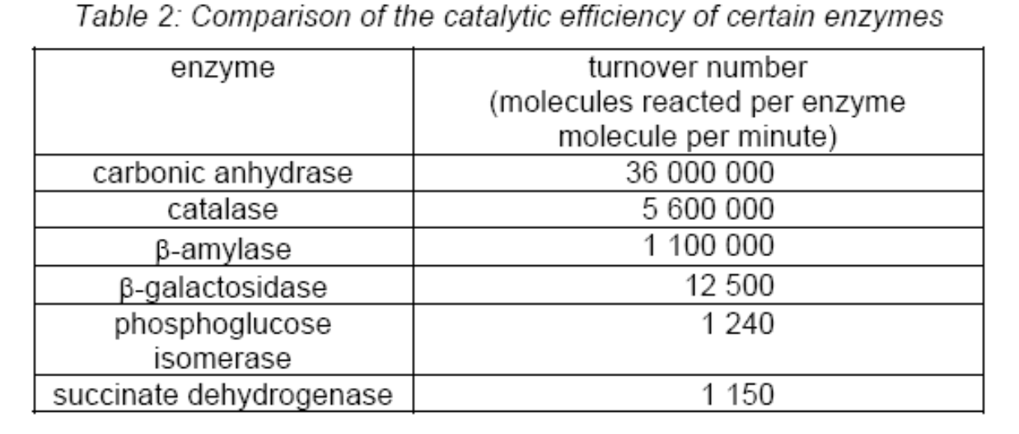
Enzymes
Enzymes are very specific: generally catalysing only one particular reaction.
Each enzyme has a specific substrate, the substrate being the target molecule acted upon during the enzyme-catalysed reaction.

Slide 4
Enzymes
Higher reaction rates – the rates of enzyme catalysed reactions are typically increased by factors of 106 to 1012 times compared to the uncatalysed reaction and are several orders of magnitude greater than those of the corresponding chemically catalysed reaction.
Milder conditions – enzyme catalysed reactions occur under relatively mild conditions: temperatures below 100°C, atmospheric pressure, and at pH’s around neutrality.
Greater reaction specificity – enzymes have a vastly more defined specificity with regard to their substrate and products: enzyme catalysed reactions are ‘clean’ and do not produce side products.
Capacity for regulation – the catalytic activities of many enzymes can be varied by the concentrations of substances other than the substrate: the mechanism of these regulatory processes can be complex.

Slide 5
Shape of Enzymes
Water-soluble globular (i.e. curled up in a ball) proteins.
Complicated folding of the protein chain to form the tertiary structure gives rise to ‘clefts’ or ‘crevices’
Precise shape of these clefts is designed to ‘recognise’ and hold in place a particular substrate molecule while it reacts.
Known as the active site of the enzyme.
Catalytic properties and specificity of an enzyme are determined by the chemical nature of the amino acid R-groups located at the active site.

Slide 6
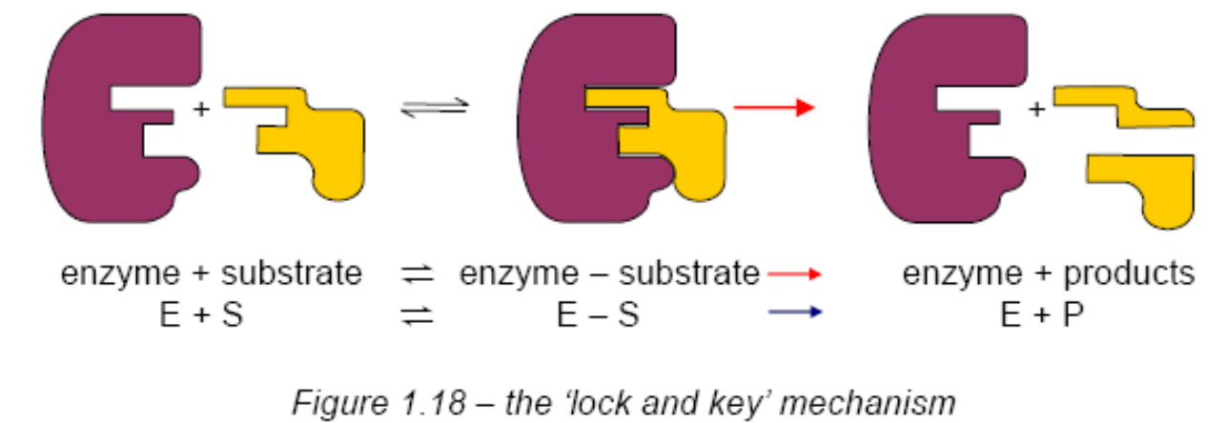
‘Lock and Key’ Model
Only one substrate will fit into the active site, just as only one key fits a lock.

Slide 7
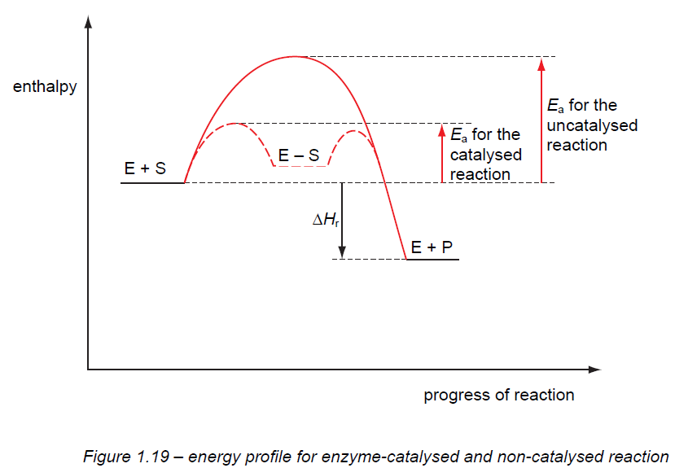
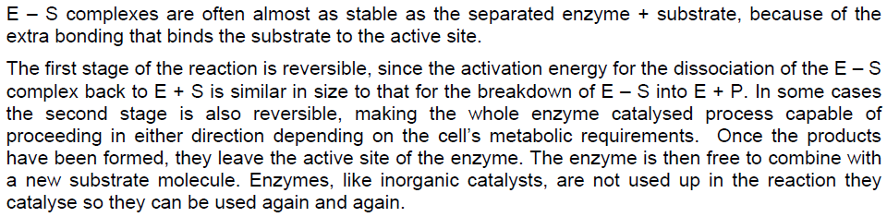
Notes:
First stage of the reaction is reversible since if the available energy is not greater than E_{a} the complex may dissociate without product being formed.
In some cases the second stage is also reversible, making the whole enzyme catalysed process capable of proceeding in either direction depending on the cells metabolic requirements.

Slide 8
Competitive Inhibition
Inhibitors - imitates the substrate in the way it binds to the enzyme.
This type of inhibitor is known as a competitive inhibitor.
Competitive inhibitors have a similar shape to the substrate molecule - can bind to the active site but cannot participate in the catalysed reaction.
When they are present in the active site no reaction is taking place and the correct substrate cannot attach to the enzyme.

Slide 9
Competitive Inhibition
Competition between the substrate and the inhibitor to occupy the active sites on the enzyme molecules.
Result of this competition depends on the relative concentrations of the substrate and inhibitor.
Functionality of the enzyme molecules is not interfered with – the active sites are merely blocked (Figure 1.21).
This type of inhibition is reversible by an increase in substrate concentration.

Slide 10
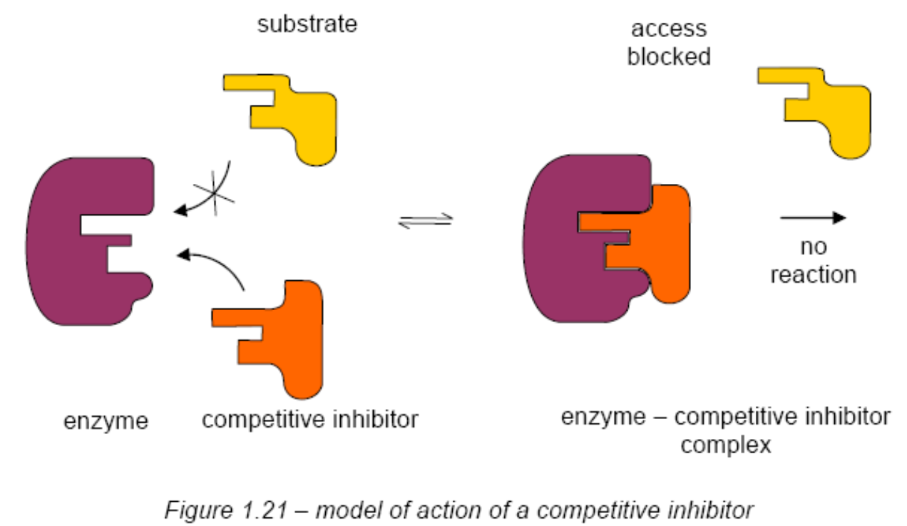
Competitive Inhibition

Slide 11
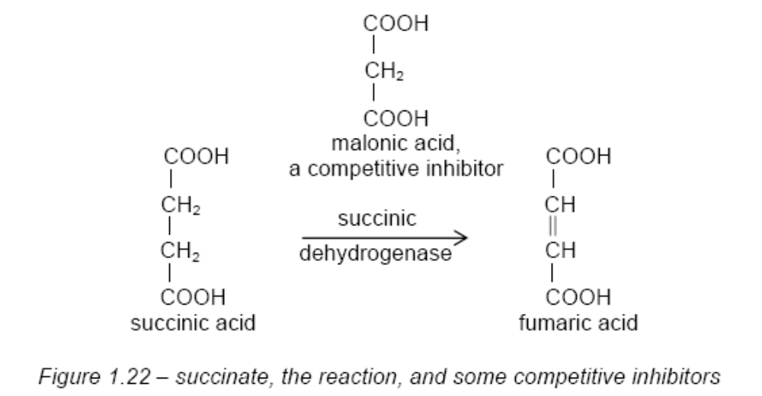
Competitive Inhibition

Slide 12
Non-competitive Inhibition
Molecules can bind on to regions of the enzyme other than the active site and affect enzyme activity.
This is known as non-competitive inhibition.
This binding is thought to cause one of the following:
  the active site to change shape so that the substrate cannot bind (Figure 1.23).
  the enzyme-substrate complex to change shape so that the reaction cannot take place.

Slide 13
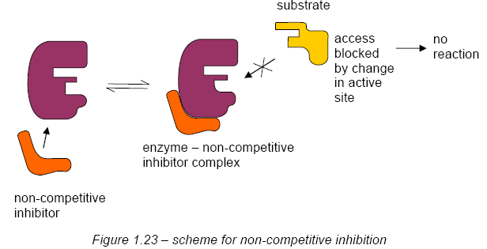
Non-competitive Inhibition

Slide 14
Non-competitive Inhibition
This inhibition cannot be overcome simply by adding more substrate.
Effect - reduce the number of active enzyme molecules available for reaction.
Most non-competitive inhibitors only bind weakly to the enzyme.
If the concentration of inhibitor falls, the enzyme-inhibitor complex falls apart and the functional shape of the enzyme is restored.
This type of inhibition is reversible.

Slide 15
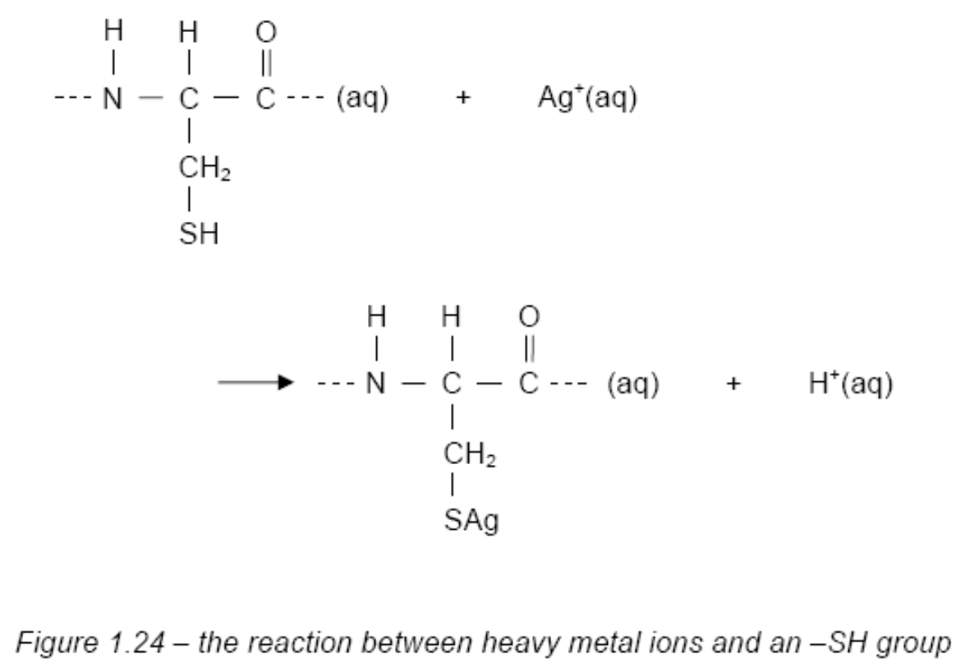
Non-competitive Inhibition

Slide 16
http://www.wiley.com/legacy/college/boyer/0470003790/animations/enzyme_inhibition/enzyme_inhibition.swf

Slide 17
Factors Affecting Enzyme Activity
Temperature
Effect of temperature on enzyme activity is complex because it is the outcome of several different factors:
  the speed of the molecules;
  the activation energy of the catalysed reaction;
  the thermal stability of the enzyme and the substrate.

Slide 18
Factors Affecting Enzyme Activity
Temperature
At relatively low temperatures (around 0°C) the rate of most enzyme-catalysed reactions is very low.
The enzyme is said to be deactivated by low temperature.
Increasing temperature increases the rate of enzyme activity since the molecules involved have greater kinetic energy as the temperature rises.

Slide 19
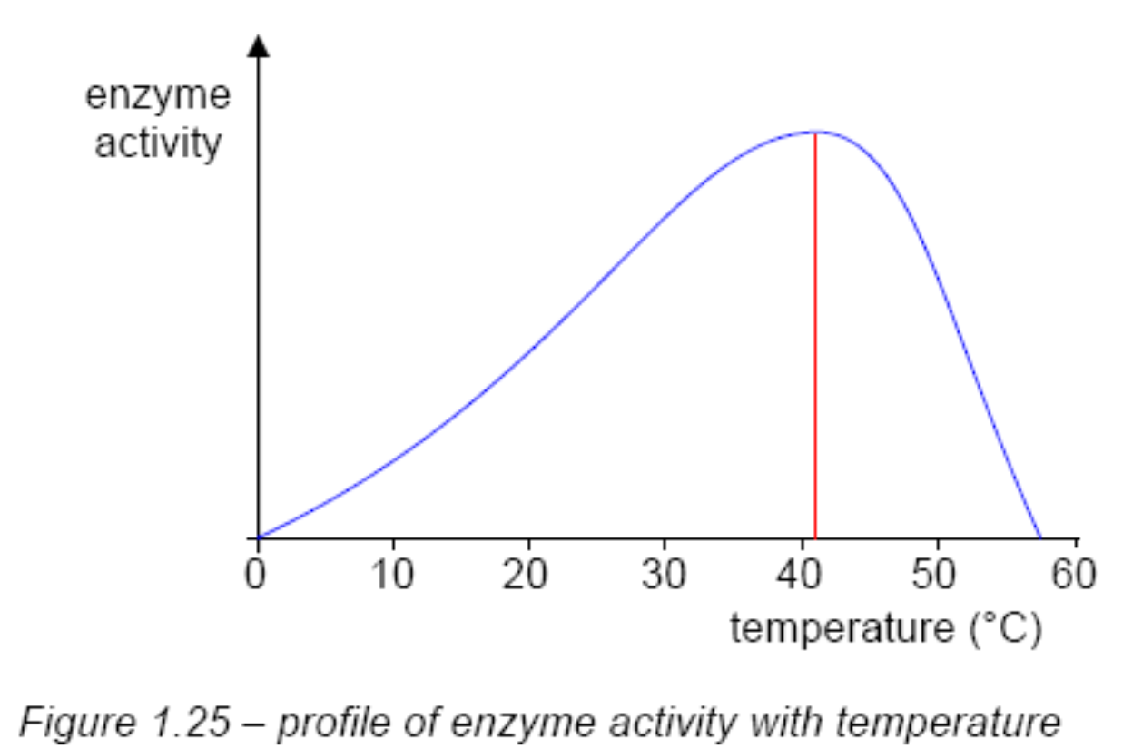
Factors Affecting Enzyme Activity
Temperature

Slide 20
Factors Affecting Enzyme Activity
Temperature
Rate of reaction starts to decrease above 40°C.
Increased thermal motion of the polypeptide chain is causing disruption of the forces maintaining the shape of the enzyme molecules.
The enzyme molecules are progressively denatured, causing the shape of the active site to change.
Above 65°C the enzymes from most organisms are completely heat denatured.

Slide 21
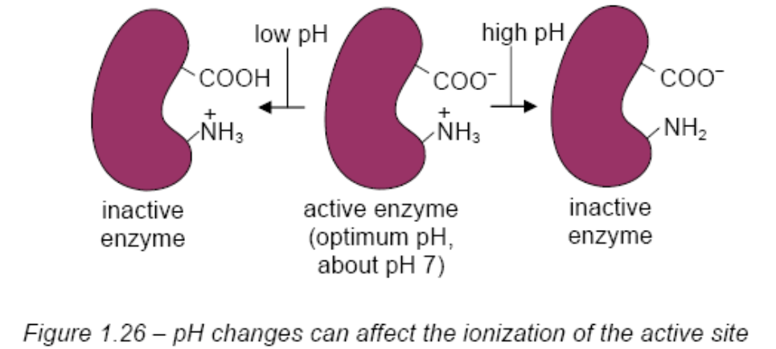
Factors Affecting Enzyme Activity
pH
Extreme pH (high acidity or alkalinity) will denature proteins by disrupting the precise three-dimensional arrangement of the protein chains.
If enzyme activity depends on particular residues in the active site being charged or not, then a shift of just one pH unit can change the enzyme activity significantly.

Slide 22
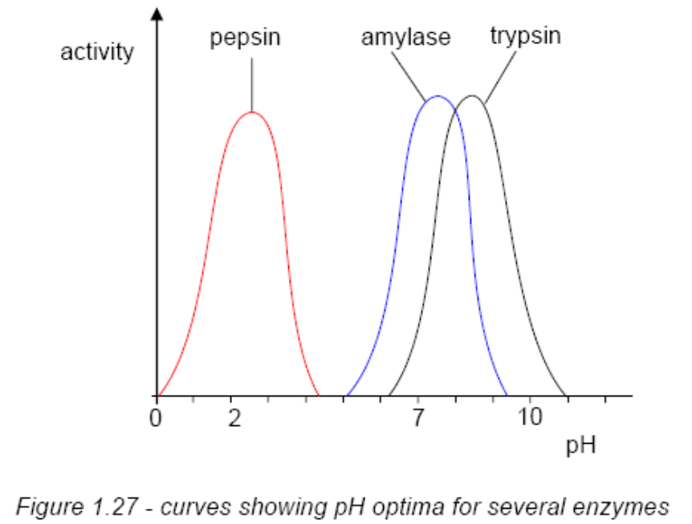
Factors Affecting Enzyme Activity
pH
Most enzymes are active over a fairly narrow range of pH.
Each enzyme has its own distinct optimum pH (Figure 1.27).

Slide 23
Chemical Denaturation
High salt concentration changes the ionic environment of an enzyme, disrupting ionic interactions between different regions of the chain, while
Urea denatures proteins by disrupting the hydrogen bonds that maintain the secondary and tertiary structure of proteins.
Certain chemical inhibitors totally inactivate enzymes; their effects are irreversible.

Slide 24
Cofactor
A cofactor is a non-protein chemical compound that is bound (either tightly or loosely) to an enzyme and is required for catalysis.
They can be considered "helper molecules/ions" that assist in biochemical transformations.
Cofactors can be divided into two broad groups:
  Coenzymes - Coenzymes are small organic non-protein molecules that carry chemical groups between enzymes. These molecules are not bound tightly by enzymes and are released as a normal part of the catalytic cycle.
  Prosthetic groups. In contrast, prosthetic groups form a permanent part of the protein structure.

Slide 25
Prosthetic Groups
For example, carbonic anhydrase, one of a group of metalloenzymes, contains a metal ion at the heart of the active site.
In carbonic anhydrase the metal ion is a Zn²⁺ ion, and its presence is absolutely essential for enzymic activity.
Notes:
Apoenzyme- An enzyme that requires a cofactor but does not have one bound. An apoenzyme is an inactive enzyme, activation of the enzyme occurs upon binding of an organic or inorganic cofactor.
Holoenzyme- An apoenzyme together with its cofactor. A holoenzyme is complete and catalytically active. Most cofactors are not covalently bound but instead are tightly bound.

Slide 26
Prosthetic Groups
Other enzymes have the haem group as a cofactor. These include cytochrome oxidase, an enzyme involved in the crucial process of respiration.
Cofactors such as these, which are an integral part of the enzyme structure, are known as prosthetic groups.

Slide 27
Coenzyme
Coenzymes, are not integral parts of the enzyme structure.
They are complex organic molecules, often derived from a vitamin.
These coenzymes, such as NAD⁺ (nicotinamide-adenine dinucleotide), work together with the enzyme to bring about the required reaction.
They bind temporarily to the active site of the enzyme and effectively function as a co-substrate, providing for the transfer of groups or electrons not readily available from the side-chains of the enzyme protein (Figure 1.29).
They are released from the enzyme at the end of the catalysed reaction.

Slide 28
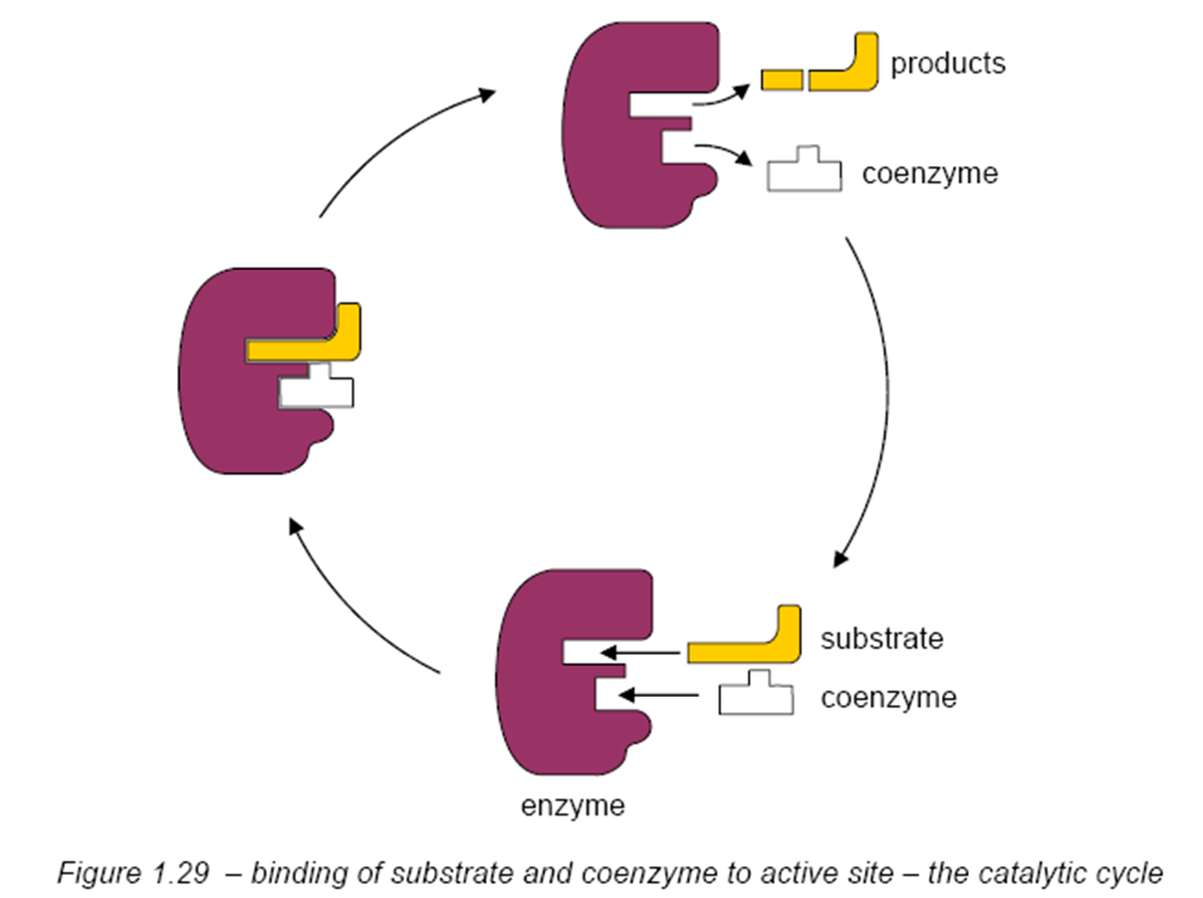
Coenzyme

Slide 29
Coenzyme
NAD⁺, NADP⁺, and FAD are important coenzymes because of their ability to accept H⁺ ions and electrons and therefore take part in redox reactions.
They are sometimes referred to as ‘hydrogen carriers’ because of their ability to transfer hydrogen atoms between reactions.
Coenzyme A acts as a carrier of CH₃COO- groups and is therefore important in the metabolism of fatty acids

Slide 30
Coenzyme
Both NAD⁺ and FAD are derived from the water-soluble B group vitamins.
In humans, an inadequate supply of these precursors gives rise to deficiency diseases.

Slide 31
Ion channels
Ion channel receptors are located in the plasma membrane.
Each of these proteins arranges itself so that it forms a passageway or pore extending from one side of the membrane to the other.
Have the ability to open and close in response to chemical or mechanical signals.
When an ion channel is open, ions move into or out of the cell in single-file fashion.
Individual ion channels are specific to particular ions, meaning that they usually allow only a single type of ion to pass through them.

Slide 32
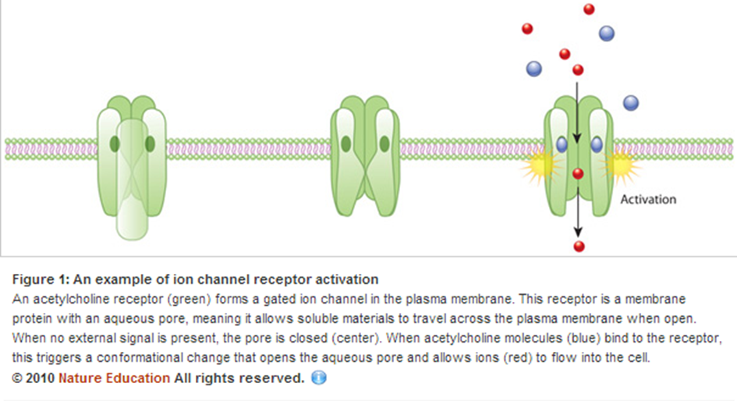
Ion channels

Slide 33
Ion channels
These channels are found to consist of protein subunits which sit across the plasma membrane – they are trans-membrane proteins.
They have enzyme-like function and, by their interaction with ions such as
Na⁺
K⁺
relatively small molecules such as ATP (adenosine triphosphate)
these proteins are able to selectively control the transport of ions into, and out of, the cell.
In a manner similar to enzyme inhibitors certain plant alkaloids, oubain, for instance, can interfere with ion transport by interacting with the protein units of the ion channels.

